Slide 1
Capstone Project-3
Credit Card Default Prediction
By
Rahul chauhan

Slide 2
Discussion Points
The Dilemma
Data Pipeline
Define Independent variable
EDA
Relation with Independent
Preparing dataset for model
Apply Baseline model
Model validation and selection
Conclusion

Slide 3
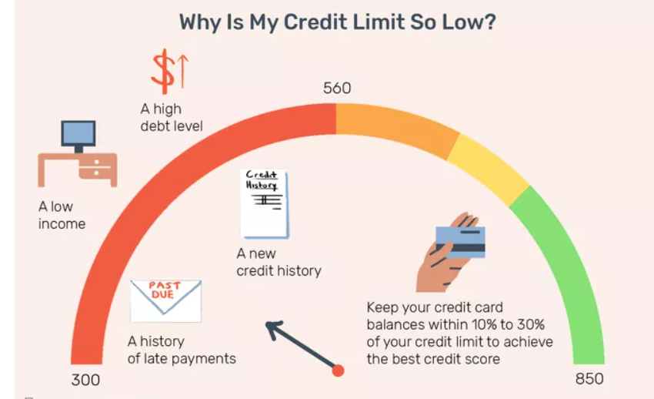
The Dilemma
The credit card default is one of the major issues increasing day by day, to solve this we develop a ML model .ML model help us to catch the credit card default customer and try to reduce the fraudster customer.
The data show us the behavior of customer as like payment history for different months, how much the bill is come and how much they paid.
We try to catch the fraudster and the bank does not repeat the mistake.
If the customer does not paying their installment month to month so it has the probability that customer will default for their transaction and loose their claim from credit card.
In short Credit Card Default Prediction is to build a model to identify whether the credit card applicant will default or not based on his repayment history and other important factors. In order to achieve this, we need to develop a supervised machine learning model using classification algorithms.

Slide 4
Data Pipeline
Data processing-1 :In this Part we’ve removed unnecessary feature. since there were many column with null values which have to check.
Data processing-2 :In this part , we go manually through each features selected from part 1, and changed the columns containing date and time values, which we will extract into some readable format.
EDA: In this part we do some exploratory data analysis(EDA) on the features selected in part-1 and 2 to see the trend.
Create model: Finally, in this last but not the last part, we creates models. Creating a model is also not an easy task. It’s also an iterative process. We show how to start with a simple model, then slowly and complexity for better performance

Slide 5
Data Summary
ID - The unique ID of the customer.
LIMIT_BAL - Your credit limit is the maximum amount you can borrow using a credit card or line of credit.
SEX – The sex of the customer i.e Male, Female and others.
EDUCATION – Customer classified according to education category as like graduate school, university, high school and others.
MARRIAGE – The marital status as like married, single and others.
AGE – The different ages of customer.
PAY_0 – The payment status for September 2005.
PAY_2 - The payment status for August 2005.
PAY_3 – The payment status for July 2005.

Slide 6
Data Summary
PAY_4 – The payment status in June, 2005.
PAY_5 – The payment status in May, 2005.
PAY_6 – The payment status in April, 2005.
BILL_AMT1 – Amount of bill statement in September, 2005.
BILL_AMT2 – Amount of bill statement in August, 2005.
BILL_AMT3 – Amount of bill statement in July, 2005.
BILL_AMT4 – Amount of bill statement in June, 2005.
BILL_AMT5 – Amount of bill statement in May, 2005.
BILL_AMT6 – Amount of bill statement in April, 2005.

Slide 7
Data Summary
PAY_AMT1 – The total payable amount of the bill for the month of September, 2005.
PAY_AMT2 – The total payable amount for the month of August, 2005.
PAY_AMT3 – The total payable amount for the month of July, 2005.
PAY_AMT4 – The total payable for the month of June, 2005.
PAY_AMT5 – The total payable for the month of May, 2005.
PAY_AMT6 – The total payable for the month of April, 2005.
DEFAULT – The binary number for the default customer, 1 – Yes and 0 – No.

Slide 8
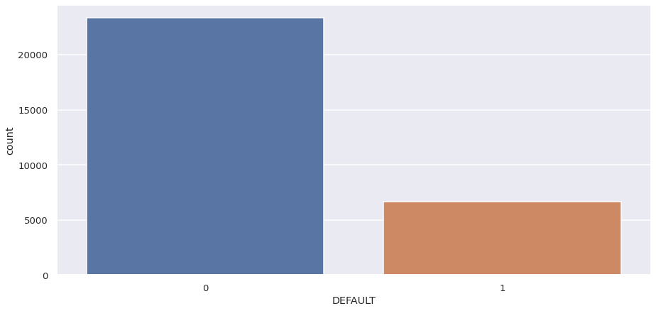
Define Dependent Variable
The DEFAULT have the binary variable 1 and 0.
1 – The Default customer.
0 – The Non-Default customer.
The customer who delay for their monthly payment or not pay their full payment is called as Default customer.
The customer who are paying their payment monthly or pay their full bill is called as Non-Default customer.
Most of the customer are non default for their payment history.
There are some of the customer are default so we just identify and move out from the issued credit card.

Slide 9
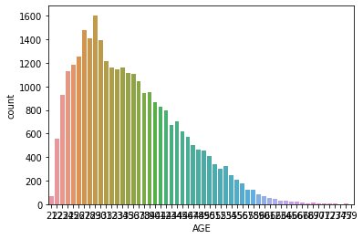
EDA
What is the age of the customer and how many customer are from which age so we can deal with the customer separately. This helps us to avoid confusion while dealing with the different age of customer. So we can conclude from the below graph that the top five range of customer are from 29, 27, 28, 30, 26.

Slide 10
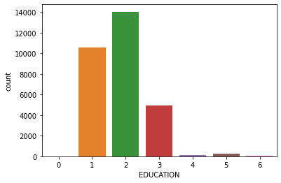
EDA
1 = graduate school 2 = university 3 = high school 0 = others
From the graph we can conclude that
the majority are for graduate school and
University school.

Slide 11
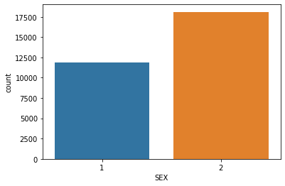
EDA
Counting of male and female

Slide 12
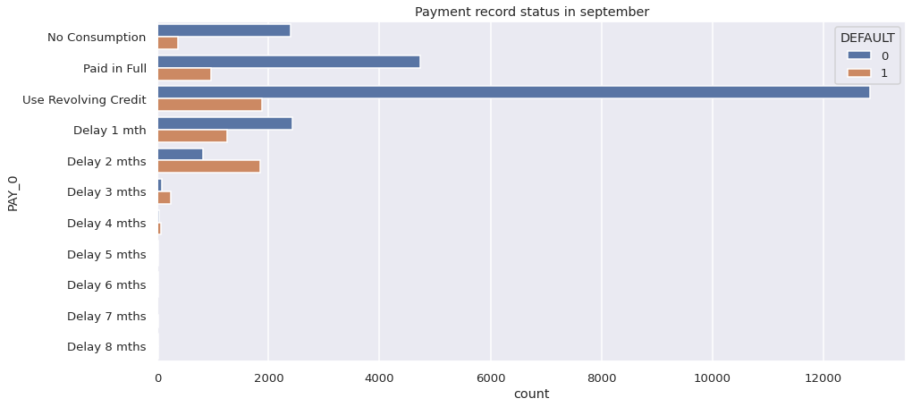
EDA

Slide 13
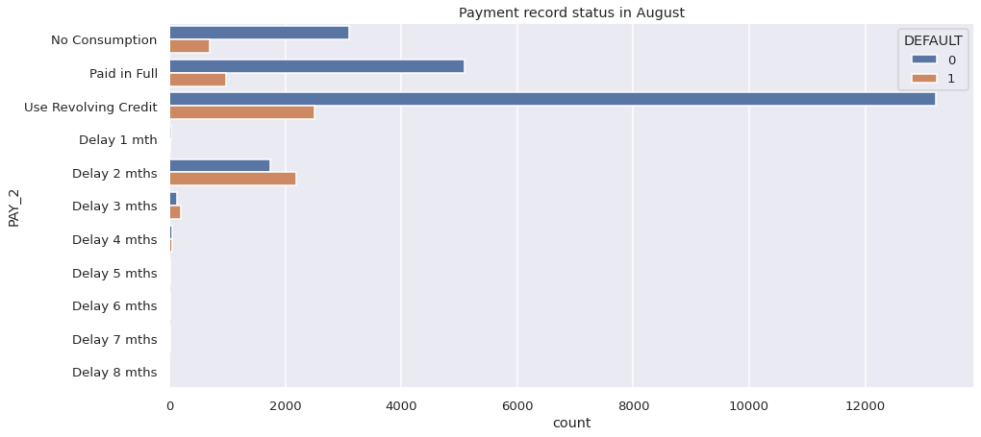
EDA

Slide 14
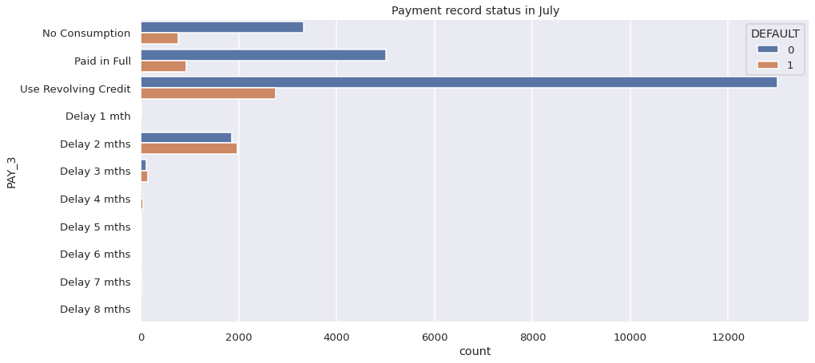
EDA

Slide 15
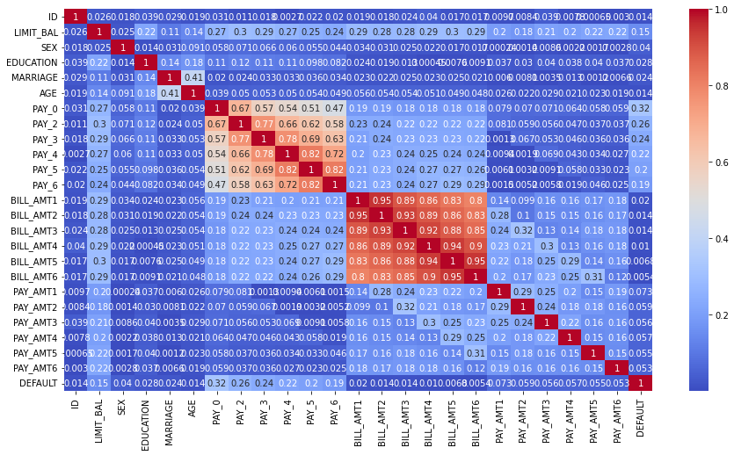
EDA (Correlation)

Slide 16
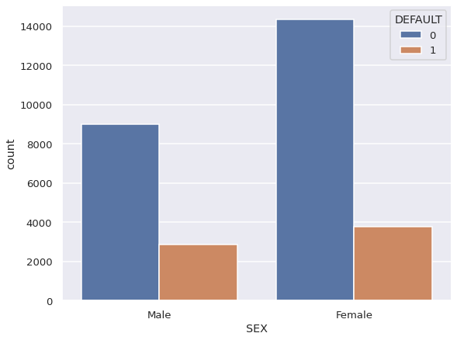
Sex VS Default (Relation)

Slide 17
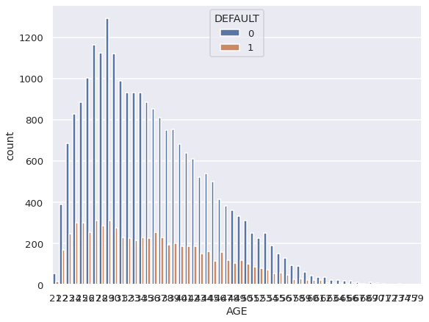
Age VS Default (Relation)

Slide 18
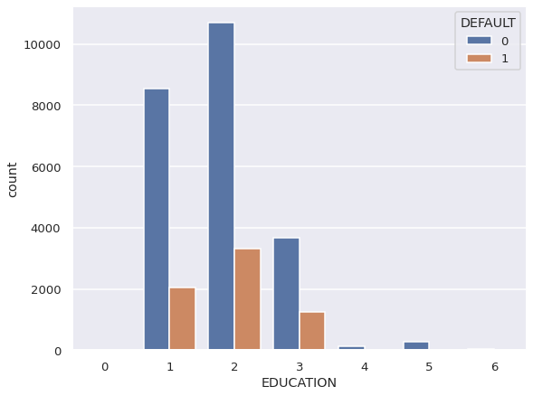
Education VS Default (Relation)

Slide 19
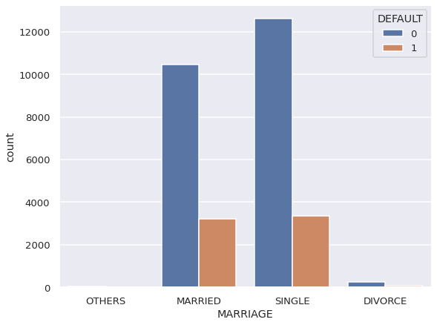
Marriage VS Default (Relation)

Slide 20
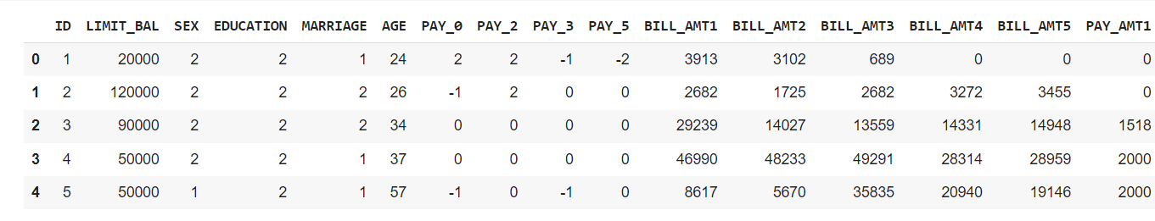
Preparing Data For Model
Training Set:-(37382,21)
Testing Set:- (9346,21)

Slide 21
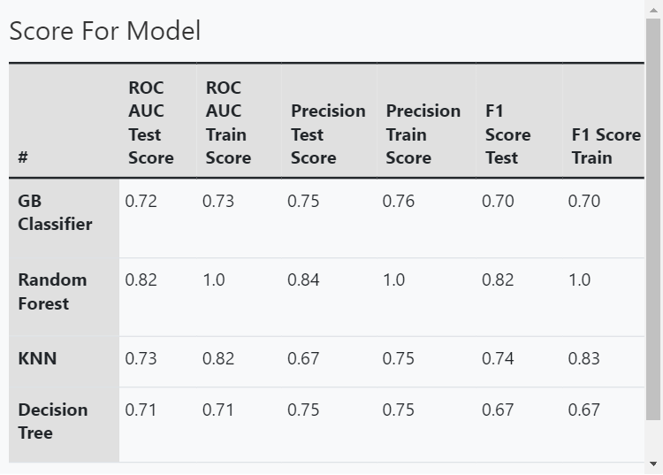
Applying Baseline Model

Slide 22
Model Validation & Selection(Confusion Matrix)
Test Data Train Data
For GB Classifier confusion matrix is: [[2390, 1035] [ 644, 2008]] For Random Forest confusion matrix is: [[2582, 581] [ 452, 2462]] For KNN confusion matrix is: [[1766, 465] [1268, 2578]] For Decision Tree confusion matrix is: [[2384, 1025] [650, 2018]]
For GB Classifier confusion matrix is: [[9724, 4171], [ 2434, 7978]] For Random Forest confusion matrix is: [[12158, 0] [ 0, 12149]] For KNN confusion matrix is: [[8541, 949] [3617, 11200]] For Decision Tree confusion matrix is: [[9555, 4237] [2603, 7912]]

Slide 23

Model Validation And Selection
Observation 1: From the above table we get to see that GB Classifier and Decision Tree model are not perform well. So in accordance with we trained a different model as like Random Forest and KNN.
Observation 2: Then we see that both Random Forest and KNN are perform well on training and testing dataset. But after checking the F1 score we conclude the result that Random Forest are more good model as compared to KNN.

Slide 24

Final Selection of Model
Observation 3:- Now finally we can conclude that Random Forest is a good classifier model hence we can go up with this model.
As when we are dealing with this evaluation metrics such as precision, recall, F1 score, etc. then here we are getting a good score in Random Forest Classification.

Slide 25
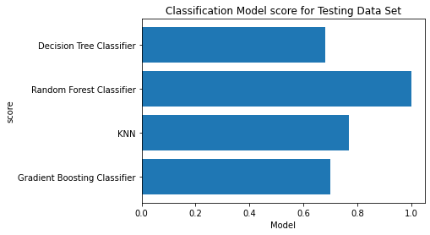
Visualizing Results

Slide 26

Conclusion
Dealing with the large data is the most crucial part to overcome with it, hence reducing complexity is the major part to handle with dataset.
We train the different model like Decision Tree Classifier, Random Forest Classifier, KNN and Gradient Boosting classifier and predict the score.
The Decision Tree and Gradient Boosting Classifier are not giving us the best prediction for model and on the another side, KNN and Random Forest giving the best prediction.
There is almost same default score for both male and female customers.

Slide 27
Conclusion
we analyze customer history of use of credit card from different months and there is less default customers who is paying their payment monthly and use as revolving card.
Choosing Hyper parameter tuning is the case sensitive model so we have to take very much care of it.
By visualizing relation with dependent and independent variable we covered information of default customers by Education, Age, Marriage, Sex. Each feature giving a major information about total number of defaulters in this class.
In Random Forest classifier we are getting the positive outcomes so from this our conclusion is that Random Forest is the best predictive model.

Slide 28

Challenges
The perfect model defines as the model which have a higher accuracy.
The total efforts are made to bring the high accuracy in the model. So dealing with higher accuracy is not the easiest part.
The credit card default dataset has some robust data, so we have to deal with it by removing outlier and filling null values in short we have to clean the data that also one of the major important part for develop a good model.
Dealing with the imbalanced data is quite difficult, so we just trying to balance data and make some good predictive model.
Choosing the best value for hyper parameter tuning is the most case sensitive part.

Slide 29
THANKYOU!

